Slide 1


Slide 2
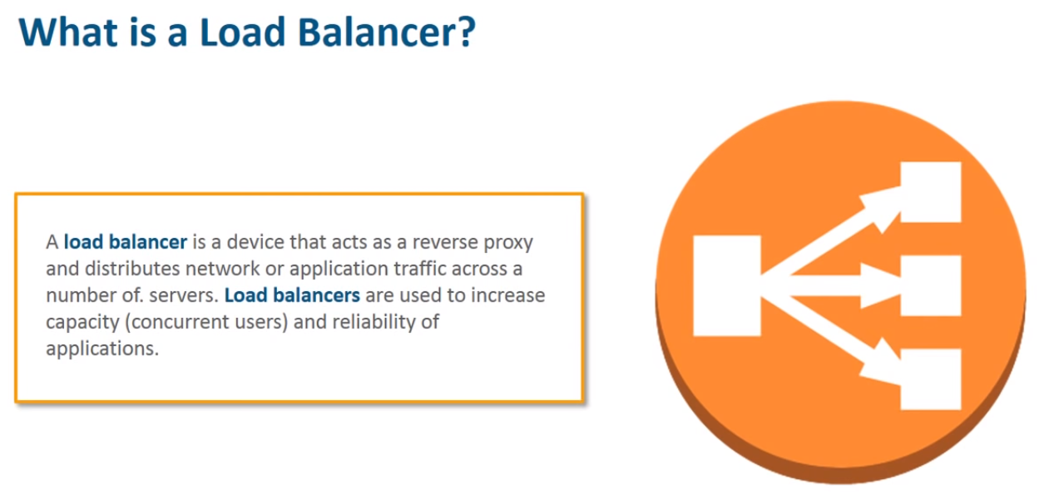

Slide 3
Classic Load Balancer
Classic Load Balancer provides basic load balancing across multiple Amazon EC2 instances and operates at both the request level and connection level.
Classic Load Balancer is intended for applications that were built within the EC2-Classic network.
Classic Load Balancer distributes incoming application traffic across multiple EC2 instances in multiple Availability Zones.

Slide 4
Features of Classic Load Balancer
A load balancer distributes incoming application traffic across multiple EC2 instances in multiple Availability Zones. This increases the fault tolerance of your applications. Elastic Load Balancing detects unhealthy instances and routes traffic only to healthy instances.
Your load balancer serves as a single point of contact for clients. This increases the availability of your application. You can add and remove instances from your load balancer as your needs change, without disrupting the overall flow of requests to your application.
Elastic Load Balancing scales your load balancer as traffic to your application changes over time. Elastic Load Balancing can scale to the vast majority of workloads automatically.

Slide 5
Features of Classic Load Balancer
A listener checks for connection requests from clients, using the protocol and port that you configure, and forwards requests to one or more registered instances using the protocol and port number that you configure. You add one or more listeners to your load balancer.
You can configure health checks, which are used to monitor the health of the registered instances so that the load balancer only sends requests to the healthy instances.

Slide 6
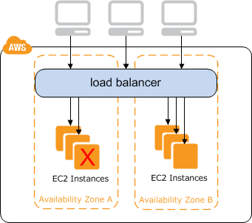
Classic Load Balancer

Slide 7
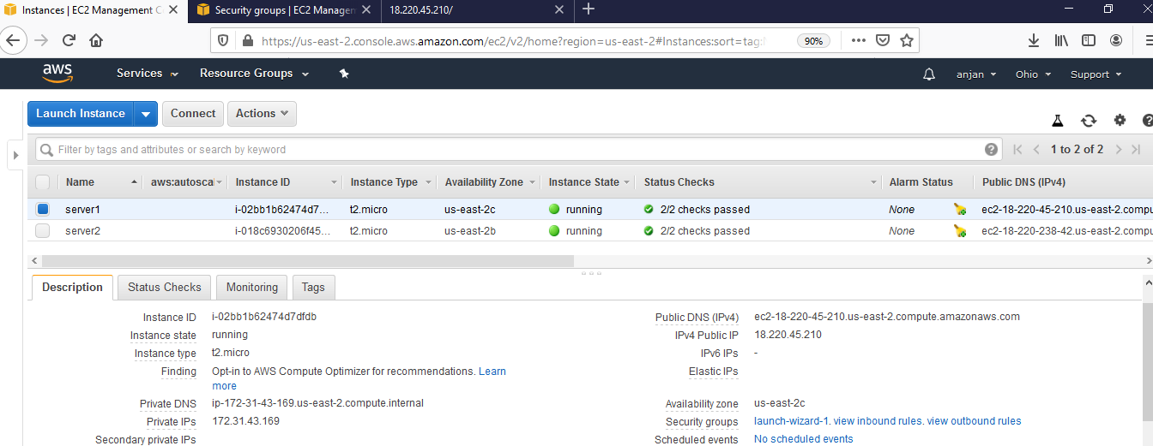
First create 2 EC2 Instances in 2 different zone

Slide 8
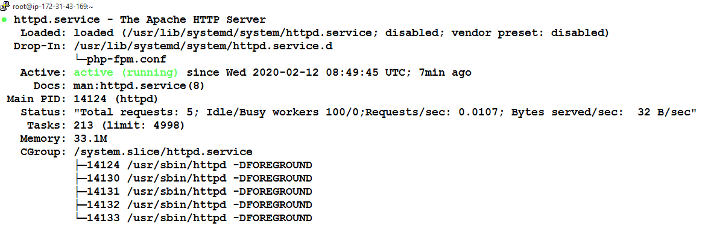
Install PHP with apache and run a html page on both servers
yum install php
systemctl start httpd
systemctl status httpd
In server1
echo "<h1>Server1</h1>">/var/www/html/index.html
In server2
echo "<h1>Server2</h1>">/var/www/html/index.html

Slide 9
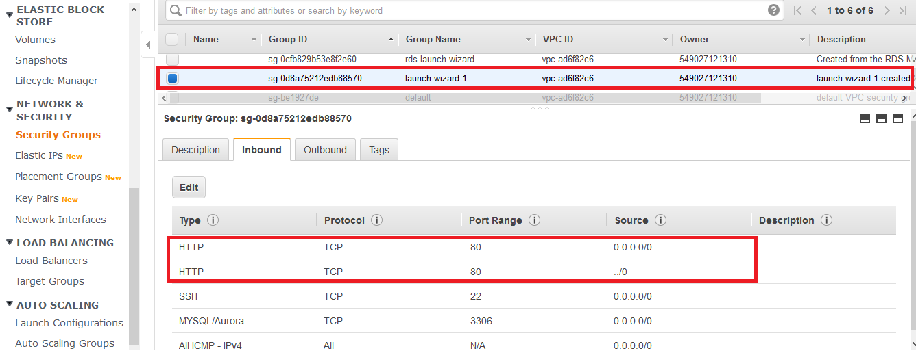
Also check the policy in the security group

Slide 10

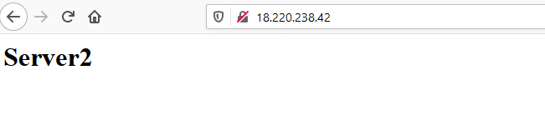
Test apache is running

Slide 11
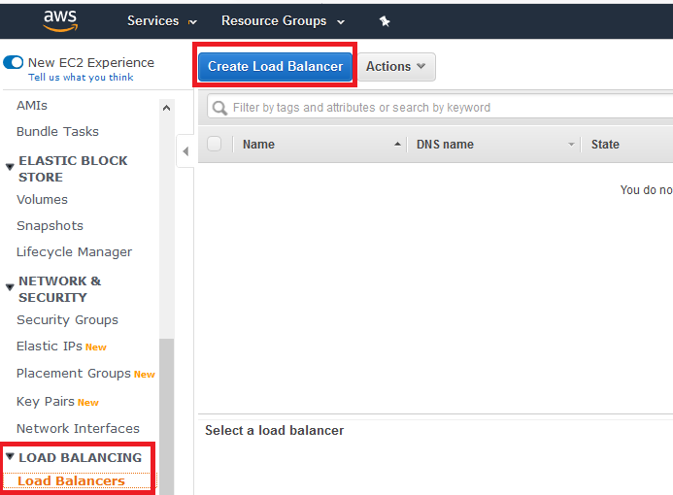
Create Load Balancer

Slide 12
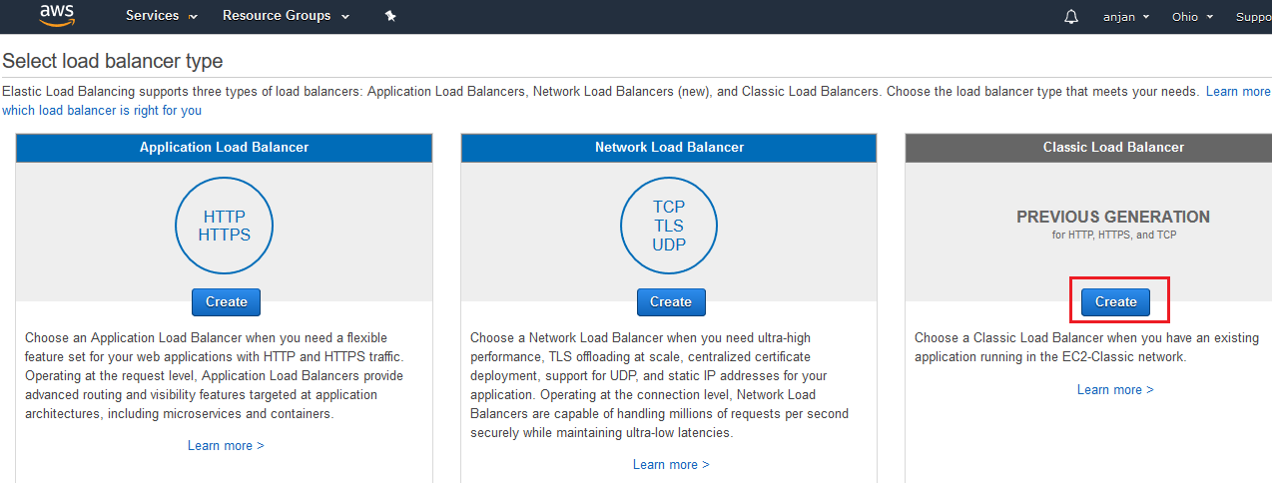
Select the classic load balancer

Slide 13
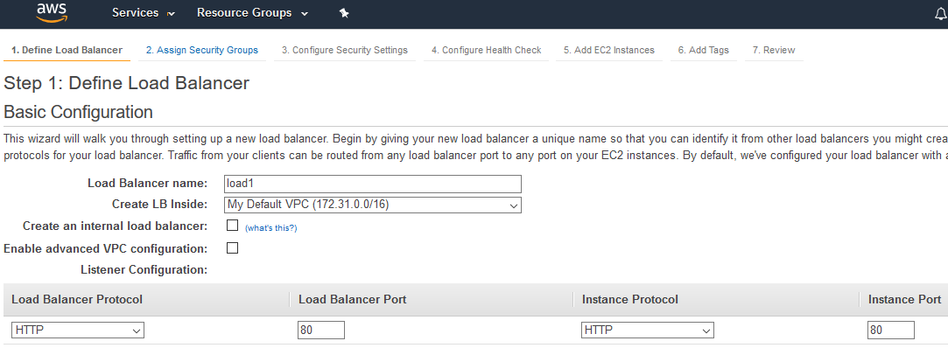
Name the load balancer and select the http protocol

Slide 14
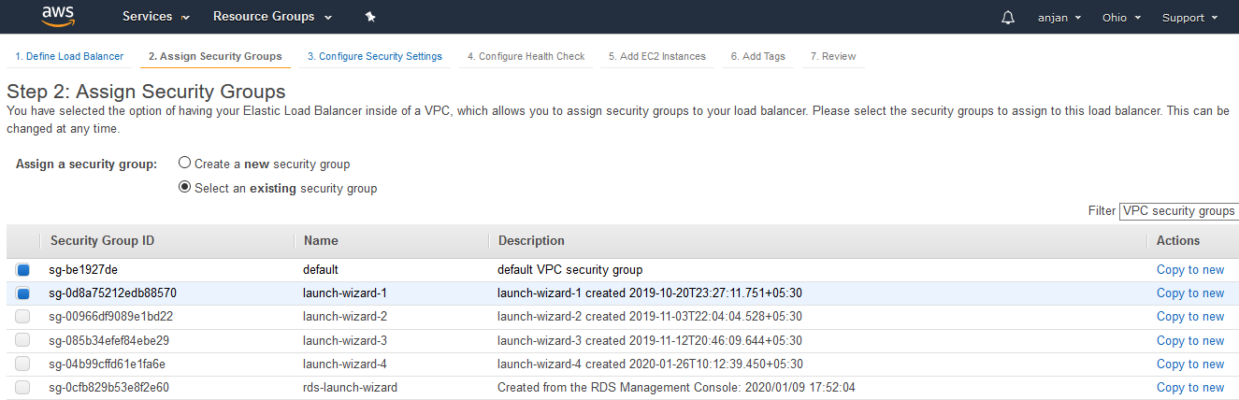
Allocate the Security Group

Slide 15
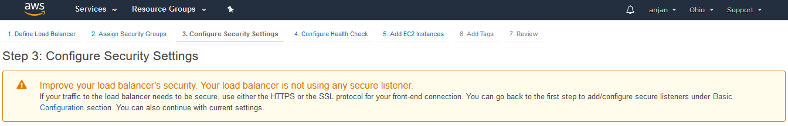
Configure Security

Slide 16
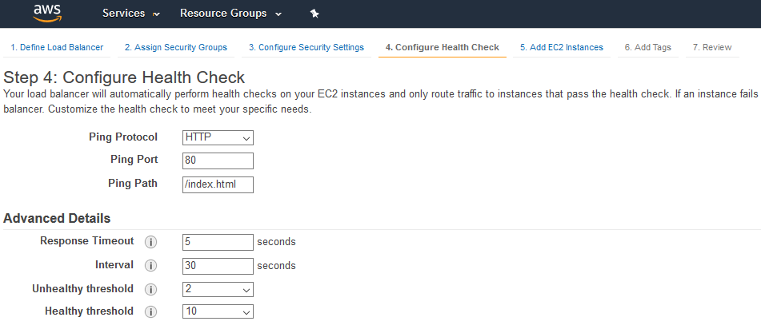
Configure Health Check

Slide 17
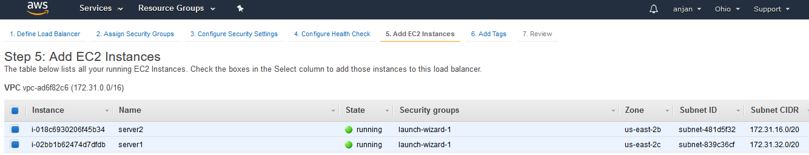
Attach the EC2 Instance

Slide 18
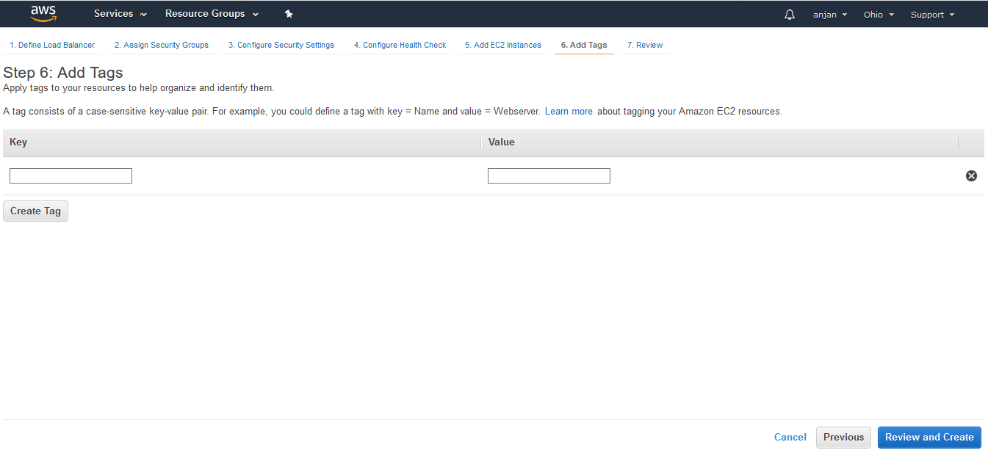
Review

Slide 19
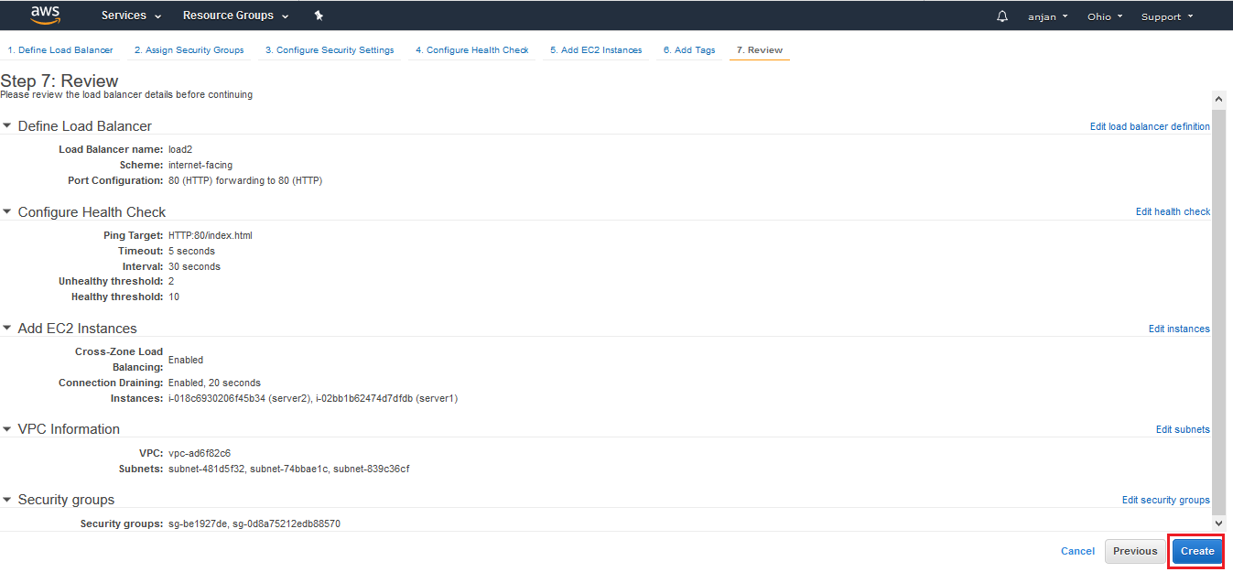
Create the Load Balancer

Slide 20
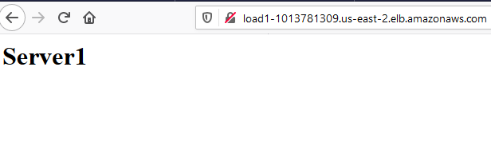
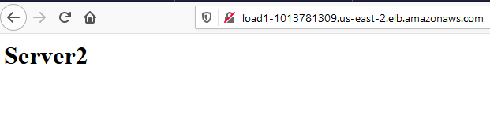
Test Output of Load Balancer

